Slide 1

Sentinel AI:
Smart City Emergency Response System
Group No. 4
Group members with Student Id
Krish Jaswal – 21107039
Varad Joshi – 21107002
Shravani Kulkarni – 21107063
Khushi Kadam - 21107031
Project Guide
Ms. Rajashri Chaudhari

Slide 2
Contents
Abstract
Introduction
Objectives
Literature Review
Research Gap
Problem Definition
Scope
Technological Stack
Proposed System Architecture/Working
Prototype Design Demonstration
Implementation Status
Review Suggestions (Given in Last meeting)

Slide 3
Abstract
Real time problems and challenges
With increasing urbanization, there is a growing risk of emergencies due to the higher concentration of people in densely populated areas. Emergency response teams often face delays because of the lack of real-time data, making it difficult to respond quickly and effectively. Additionally, insufficient communication between various emergency services further complicates coordinated efforts in handling emergency situations. At the same time, the collection of data in public spaces to improve response times raises concerns about privacy and the proper handling of personal information.
Overall Idea
“Sentinel AI” revolutionizes urban safety by integrating personal and smart city sensors into a centralized hub. It utilizes multimodal AI on edge nodes to autonomously detect emergencies such as gas leaks, fires, and accidents. Once an emergency is identified, authorities are instantly notified, with privacy and data security ensured throughout the process. The solution also includes a user-friendly mobile app for reporting incidents and provides a dashboard for emergency services, enhancing communication and improving response times.

Slide 4
Introduction
Real-Time Observation of Problem Domain:
Urban Safety Concerns: Rapid urbanization increases fires, gas leaks, and accidents in cities
Inefficient Emergency Response: Traditional systems lack real-time data, causing delays and safety risks
Fragmented Communication: Fragmented communication between agencies hampers emergency responses
Privacy Issues: Existing systems collect excessive data without proper safeguards

Slide 5
Current Solutions and Issues:
Basic Alarm Systems: Smoke detectors and gas alarms aren't integrated with wider emergency networks, reducing their effectiveness
Manual Reporting Mechanisms: Emergency services rely on calls or texts, causing delays and possible misinformation
Lack of Analytics: Current systems lack advanced analytics, preventing cities from improving infrastructure or predicting future incidents
Motivation:
Personal Experiences: Witnessing delays in emergency responses during critical situations fueled a desire to find a more effective solution
Technological Advancements: The rapid development of AI and IoT technologies presents a unique opportunity to create a system that can transform urban emergency response
Community Impact: A strong commitment to enhancing community safety and quality of life by ensuring rapid and efficient emergency responses

Slide 6
Objectives
Automate Emergency Detection: Use sensors and AI to detect gas leaks, fires, and accidents, ensuring rapid reporting to authorities
Enhance Coordination Among Emergency Services: Centralized platform enhances communication and data sharing for efficient crisis management
Develop a User-Friendly Mobile App: Develop an app for citizens to report emergencies, triggering instant alerts to response teams
Implement Advanced Analytics for Infrastructure Improvement: Create a dashboard for emergency trends, helping city planners improve safety and infrastructure

Slide 7
Literature Review
Sr.no | Title | Author(s) | Year | Methodology | Drawback
1 [1] | An Accident Detection and Classification System Using Internet of Things and Machine Learning | Mohammed Balfaqih, Soltan Abed Alharbi, Moutaz Alzain, Faisal Alqurashi, Saif Almilad | 2022 | Data from sensors processed by a microcontroller; accidents classified by machine learning algorithms | GMM has the highest time complexity; implementation requires a reliable IoT infrastructure and the hardware setup involves multiple sensors
2 [2] | A Smart Building Fire and Gas Leakage Alert System with Edge Computing and NG112 Emergency Call Capabilities | Evangelos Maltezos, Konstantinos Petousakis, Aris Dadoukis, Lazaros Karagiannidis, Eleftherios Ouzounoglou, Maria Krommyda, George Hadjipavlis, Angelos Amditis | 2022 | Multisensor-based system with edge computing and automated NG112 emergency call functionality, using IoT devices, sensor nodes, and a distributed edge computing platform (DECIoT). | Limited to certain types of sensors, potential false positives requiring confirmation, does not handle image or video processing.
3 [3] | Fire Detection Method in Smart City Environments Using a Deep-Learning-Based Approach | Kuldoshbay Avazov, Mukhriddin Mukhiddinov, Fazliddin Makhmudov, Young Im Cho | 2022 | Developed a novel convolutional neural network based on an enhanced YOLOv4 algorithm for fire detection | False positives in certain scenarios like sunrise/sunset due to color intensity, complexity in handling real-time systems

Slide 8
Literature Review
Sr.no | Title | Author(s) | Year | Methodology | Drawback
4 [4] | City Alerts: Smart City Notification Platform Based on Public Open Data | Daniel Rusu, Silviu Vert | 2014 | - Collection and integration of open data from various public agencies - Use of public APIs and file uploads | - Challenges in integrating diverse data formats from public agencies - Limited to non-emergency alerts
5 [5] | A Distributed Multi-Tier Emergency Alerting System Exploiting Sensors-Based Event Detection to Support Smart City Applications | Daniel G. Costa, Francisco Vasques, Paulo Portugal, Ana Aguiar | 2020 | Distributed multi-tier system with sensors-based event detection to generate georeferenced emergency alarms based on scalar sensor data, GPS, and risk zones. | Limited to scalar sensor data, reliance on specific hardware (e.g., Raspberry Pi), potential challenges in scaling to very large cities without optimization
6 [6] | Object Tracking for a Smart City Using IoT and Edge Computing | Hong Zhang, Zeyu Zhang, Lei Zhang, Yifan Yang, Qiaochu Kang, Daniel Sun | 2019 | Proposed a region proposal correlation filter for object tracking in IoT and edge computing, using a lightweight computing algorithm for real-time tracking | Limited to visual object tracking, challenges with long-term tracking under occlusion or fast motion

Slide 9
Literature Review
Sr.no | Title | Author(s) | Year | Methodology | Drawback
7 [7] | Design and Implementation of a Smart IoT Based Building and Town Disaster Management System in Smart City Infrastructure | Sangmin Park, Soung Hoan Park, Lee Won Park, Sanguk Park, Sanghoon Lee, Tacklim Lee, Sang Hyeon Lee, Hyeonwoo Jang, Seung Min Kim, Hangbae Chang, Sehyun Park | 2018 | AR-based disaster management system providing real-time fire alerts and evacuation guidance using IoT, AI, and big data, integrated with smart city infrastructure for rapid response. | Relies heavily on sensor accuracy, possible delays in real-time updates, limited testing on large-scale deployments.
8 [8] | Geospatial Dashboards for Monitoring Smart City Performance | Changfeng Jing et al. | 2019 | Literature review | The veracity of geospatial data affects geospatial dashboards.2 Existing applications focus on data fusion to provide city performance measurements, rather than developing a big geospatial data analysis model for knowledge extraction.
9 [9] | Triangulum City Dashboard: An Interactive Data Analytic Platform for Visualizing Smart City Performance | Mina Farmanbar and Chunming Rong | 2020 | The researchers developed a three-tier architecture for their data visualisation platform: a data layer, an application and analysis layer, and a presentation layer. | The researchers encountered a number of challenges while building the platform, including different data resolutions, heterogeneity of data types, data quality heterogeneity, legal restrictions regarding data privacy, and variations in data structure. In addition, there are issues related to data access and reuse. The validity of analysis drawn from a dashboard is contingent on the veracity of the data.151617

Slide 10
Research Gap
Current State of the Problem:
Unresolved Issues:
  Systems not fully integrated across various emergency scenarios.
  Persistent challenges with false positives and data quality.
  Limited real-world testing of integrated Smart City systems in a large urban environment.
Gap from a Completely Solved Problem:
  Existing solutions lack comprehensive scalability and cross-functional capabilities.
  Need for a more robust integration of diverse technologies such as Real Time streaming, Machine Learning and AI Agents

Slide 11
Research Gap
Observations & Improvement Possibilities:
Better Performing Technologies:
  IoT and Edge Computing: Effective for real-time processing (Maltezos et al., Zhang et al.)
  Advanced Machine Learning Models: High potential in reducing false positives (Avazov et al., Balfaqih et al.).
Improvement Areas:
  Enhance network sensors to cover more emergency types
  Integrate advanced analytics for better decision-making
  Focus on data veracity and real-time processing capabilities

Slide 12
Research Gap
Confidence in Addressing Issues
Confidence Level: High confidence in contributing solutions in identified gaps
Justification:
  Proposed solution integrates multiple levels of processing on data and prioritizes quick response leveraging multiple machine learning models to analyze and notify authorities
  Existence of good quality datasets and multiple deep learning models for various sensors including camera feeds, gas sensors and thermal imaging sensors enables us to focus on building a prototype and fine tuning the models to our specific use cases rather than reinventing the wheel
  Experience working with technologies such as pytorch, Django/fastapi and htmx ensures seamless implementation

Slide 13
Problem Definition
Rapid urban growth increases emergency management complexity, such as fires, accidents, and disasters
Current emergency systems struggle with delayed detection, inefficient data processing, and poor resource allocation
These limitations slow response times and increase public safety risks
"Sentinel AI" aims to develop a smart city emergency response system
It uses real-time data from sensors, machine learning algorithms, and citizen engagement
The system enhances emergency detection, analysis, and management, reducing response times and improving urban safety

Slide 14
Key issues addressed:
Delayed Incident Detection: "Sentinel AI" uses IoT sensors for real-time emergency detection, reducing delays
Inefficient Data Processing: Machine learning in "Sentinel AI" processes data in real-time to identify emergencies
Resource Allocation: Predictive analytics in "Sentinel AI" improves resource deployment for quicker responses
Citizen Engagement: : A mobile app lets citizens report incidents, verified by AI for accuracy
Data Privacy and Security: "Sentinel AI" ensures encryption and secure communication for protecting sensitive data

Slide 15
Scope
Smart City Integration and Multi-Agency Coordination: Use existing infrastructure for improved emergency communication among services like police, fire, and medical responders
Focused Coverage in High-Density and Critical Areas: Focus on residential, commercial, and public spaces for rapid emergency response
Industrial Zone Application and User Engagement: Extend coverage to industrial areas and involve citizens through a mobile app for reporting incidents
Data-Driven Insights and Privacy Focus: Use analytics for emergency patterns while ensuring data privacy and consent mechanisms

Slide 16
Technological Stack
Docker, Kubernetes, VMWare Pro for deployment
Django 5.0 with async views for centralized hub
Django Channels for websockets
Django Rest Framework for Rest API
Nginx/S3 for storing and serving media and static files
FastAPI for edge nodes
Tensorflow, PyTorch, Keras for fine tuning and deploying pretrained models
React Native/Flutter for mobile app, Tailwind CSS, DaisyUI, ChartJS and AlpineJS for web interface
OpenCV for video capturing and processing
Custom simulations using Smart Phone Sensors, Prerecorded CCTV feeds and time series Datasets of air quality

Slide 17
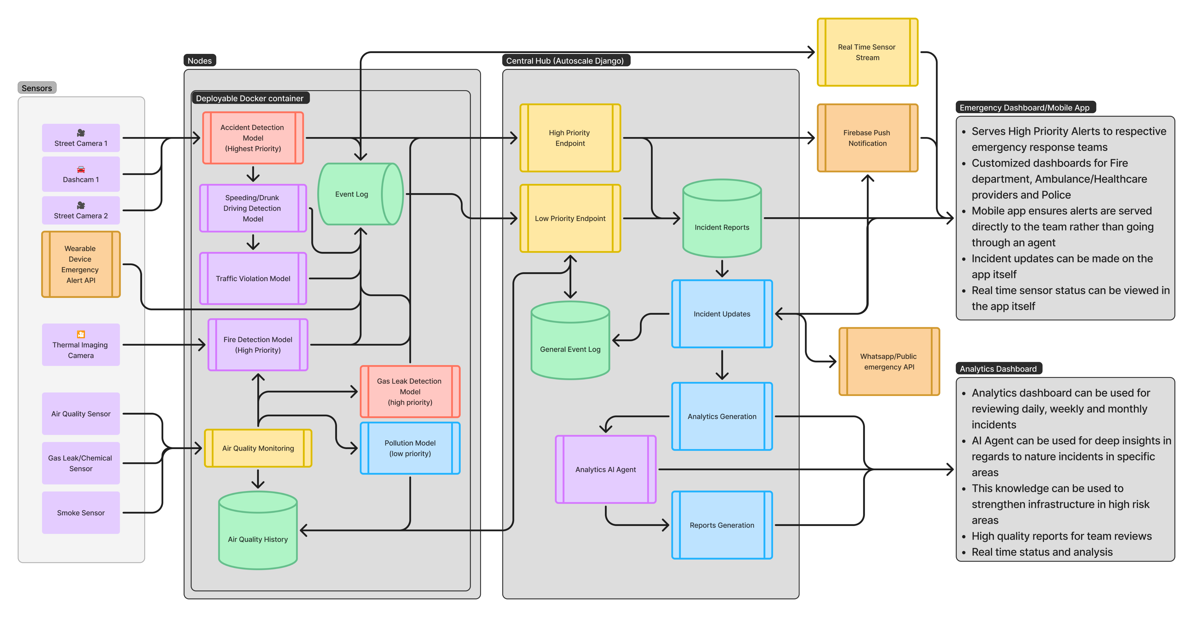
Proposed system architecture/Working

Slide 18
References
Balfaqih, Mohammed, et al. "An accident detection and classification system using internet of things and machine learning towards smart city." Sustainability 14.1 (2021): 210.
Maltezos, Evangelos, et al. "A smart building fire and gas leakage alert system with edge computing and NG112 emergency call capabilities." Information 13.4 (2022): 164.
Avazov, Kuldoshbay, et al. "Fire detection method in smart city environments using a deep-learning-based approach." Electronics 11.1 (2021): 73.
Rusu, Daniel, and Silviu Vert. "City alerts: smart city notification platform based on public open data." Sci. Bull. Politech. Univ. Timisoara Trans. Electron. Commun 59.2 (2014): 21-26.
Costa, Daniel G., et al. "A distributed multi-tier emergency alerting system exploiting sensors-based event detection to support smart city applications." Sensors 20.1 (2019): 170.
Zhang, Hong, et al. "Object tracking for a smart city using IoT and edge computing." Sensors 19.9 (2019): 1987.
Park, Sangmin, et al. "Design and implementation of a smart IoT based building and town disaster management system in smart city infrastructure." Applied Sciences 8.11 (2018): 2239.
Jing, Changfeng, et al. "Geospatial dashboards for monitoring smart city performance." Sustainability 11.20 (2019): 5648.
Farmanbar, Mina, and Chunming Rong. "Triangulum city dashboard: an interactive data analytic platform for visualizing smart city performance." Processes 8.2 (2020): 250.

Slide 19
Datasets
Accident Detection from CCTV: https://www.kaggle.com/datasets/ckay16/accident-detection-from-cctv-footage
Accident Severity dataset: https://universe.roboflow.com/razan-sendi/accident-severity-detection-dataset
Thermal Camera Flame detection dataset: https://www.mdpi.com/2571-6255/5/5/172
Smoke Detection dataset: https://www.kaggle.com/datasets/deepcontractor/smoke-detection-dataset
Chemical Gas Leak dataset: https://universe.roboflow.com/gas-leak/pipeline-leak-prediction/dataset/11
Fire, Smoke and gas leakage detection dataset: https://zenodo.org/records/6616632
Traffic Signal Violation Detection System: https://github.com/anmspro/Traffic-Signal-Violation-Detection-System
LISA Traffic Light Dataset: https://www.kaggle.com/datasets/mbornoe/lisa-traffic-light-dataset
NHTSA FARS Dataset (Fatality Analysis Reporting System): https://www.nhtsa.gov/file-downloads?p=nhtsa/downloads/FARS/

Slide 20
Thank You...!!

